Slide 1
SOFTWARE Test Automation
CH05: Introduction To Test Automation
Course Instructor: AMIR IMAM

Slide 2
Test Automation Context
Introduction
Testing and test automation are different
Test Automation Objectives
Test Automation Advantages
Test Automation Disadvantages
Test Automation Limitations
Test Automation Feasibility
Test Automation Framework
Evolution of Test Automation Framework

Slide 3
What is Test Automation
Software must be tested to have
confidence that it will work as expected.
effective at finding any defects
should also be
efficient, performing the tests as quickly and cheaply as possible.
“Automating software testing can significantly reduce the effort required for adequate testing or significantly increase the testing which can be done in limited time.”

Slide 4
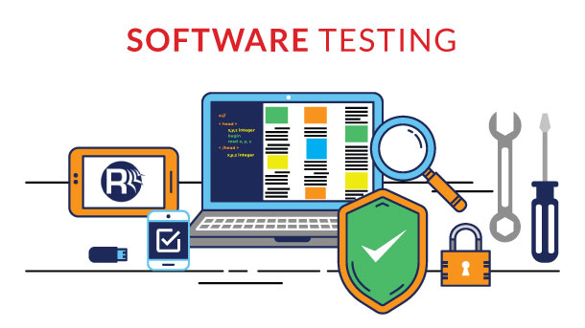
Testing and Test Automation are Different
Testing is a skill, we can have a huge number of possible
test cases and practically it is impossible to write and execute all of them.
Selection of test case to build and run is most important.
Random selection is not an effective approach to testing.

Slide 5

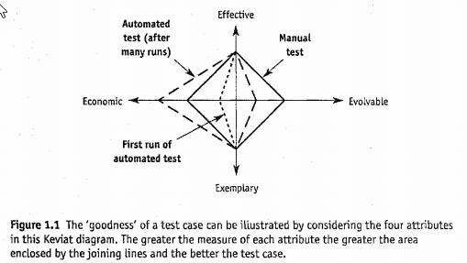
Good Test Case
Attribute of Good Test Case:
Defect detection effectiveness.
An exemplary; should be test more than one thing.
How economical a test case is to perform, analyze, and debug.
How evolvable it is, i.e. how much maintenance effort is required on the test case each time the software changes.

Slide 6
Testing and Test Automation
Testing | Test Automation
Application Expertise (SUT) | Development Expertise
What To Test | How to Test
Test Cases | Test Scripts

Slide 7
Testing and Test Automation are Different
many organizations assumes that it is more expensive to automate a test than to perform it manually…
The tests to be automated need to be carefully selected and implemented.
Automated quality is independent of test quality.
Test is automated or performed manually affects neither its effectiveness nor how exemplary it is.
Automating a test affects only how economic and evolvable it is.
Once implemented, an automated test is generally much more economical.
It is the skill of the test automator which determines how easy it will be to add new automated tests, how maintainable the automated tests will be, and ultimately what benefits test automation will provide.

Slide 8
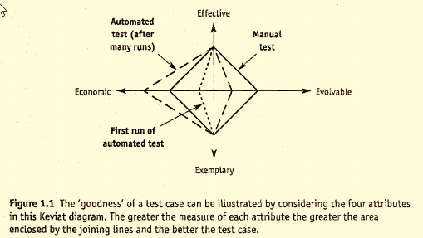
Testing and Test Automation are Different

Slide 9

AUTOMATION OBJECTIVES
Improving test efficiency
Providing wider function coverage
Reducing the total test cost
Performing tests that manual testers cannot
Shortening the test execution period
Increasing the test frequency
Reducing the time required for test cycles

Slide 10
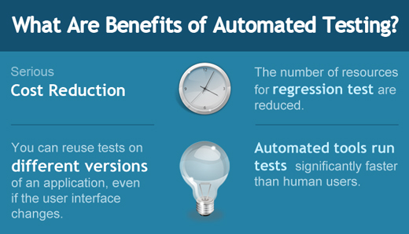
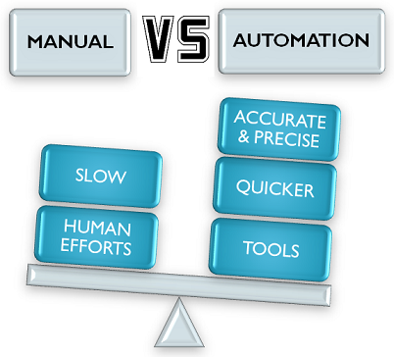
AUTOMATION ADVANTAGES
Cost Reduction in long term
Reduce HR
Re-useable
Fast
Consistent

Slide 11
AUTOMATION DISADVANTAGES
Additional costs are involved.
Requires additional technologies.
Team needs to have development and automation skills.
Can distract from testing objectives, e.g., focusing on automating tests cases at the expense of executing tests.
Tests can become more complex.
Additional errors may be introduced by automation.
On-going TAS maintenance requirement

Slide 12
Limitation
Not all manual tests can be automated.
The automation can only check machine-interpretable results.
The automation can only check actual results that can be verified by an automated test oracle.
Not a replacement for exploratory testing.

Slide 13
Success Factors in Test Automation
There are a few that should not be done, as follows:
Do not create code that is sensitive to the interface (i.e., it would be affected by changes in the graphical interface or in non-essential parts of the API).
Do not create test automation that is sensitive to data changes or has a high dependency on particular data values (e.g., test input depending on other test outputs).
Do not create an automation environment that is sensitive to the context (e.g., operating system date and time, operating system localization parameters or the contents of another application).

Slide 14

Test Automation Myth
Test Automation Myth: It is Simple; Everyone can do it’
Promoted by Sales people:
Record the Script
Enhance the script with few steps
Run and report with a button click
Under this influence, test managers think proudly that all their team members are doing automation

Slide 15

Test Automation Myth
Test Automation Truth: It is Software Development Task
It should be designed, developed and tested
Needs strong programming background in most cases
Test automation are assets and must be treated like Software development assets

Slide 16
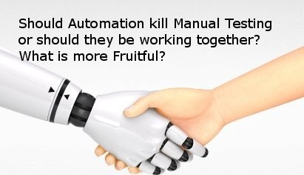
Manual Testing vs Automation Testing
Test Automation Does not Replace Manual Testing
Manual tests find more defect than automated tests
Tools have no imagination
Test automation does not improve effectiveness
Volatile Software, rare tests, impossible to verify automatically tests or test that require interaction

Slide 17
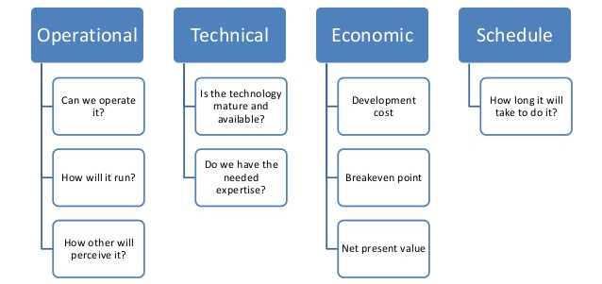
Automation Feasibility

Slide 18
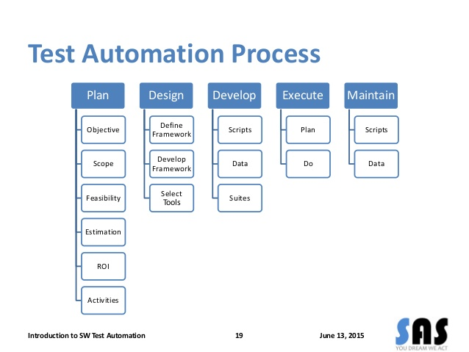
Test Automation Process

Slide 19
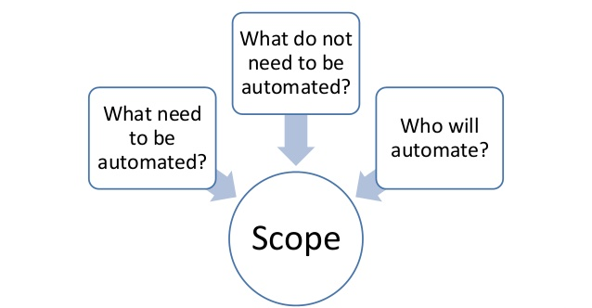
Automation Scope

Slide 20
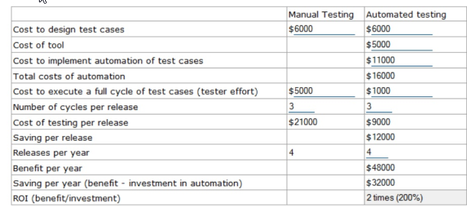
Automation Return on Investment (ROI)
Return on Investment Calculator for Test Automation

Slide 21

Automation Return on Investment (ROI)
Problem with Previous ROI Calculation
We are comparing an apple to an orange
Manual and automated testing are really different
They give different information
Cost of multiple execution of automated tests vs manual test cant be compared
You would never dream of executing that so many test cases manually

Slide 22
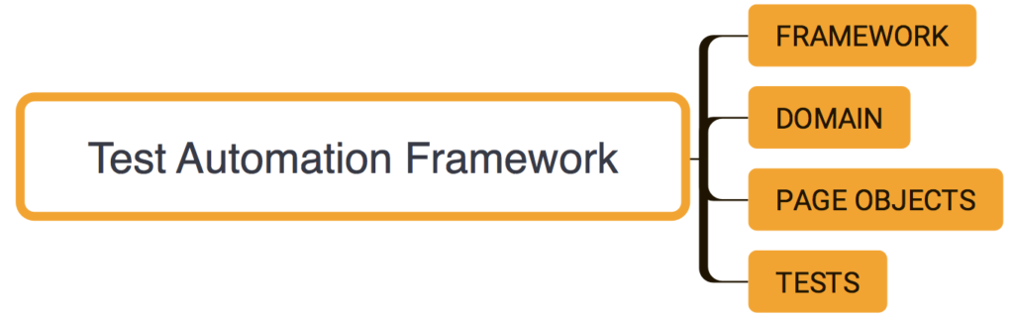
Automation Framework
A set of assumptions, concepts and tools that provide support for automated software testing
A reusable set of libraries or classes for a software system (or subsystem)
A correctly implemented test automation framework can further can further improve ROI by reducing the development and maintenance costs.

Slide 23
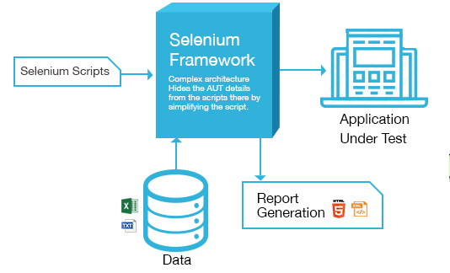
Automation Framework

Slide 24
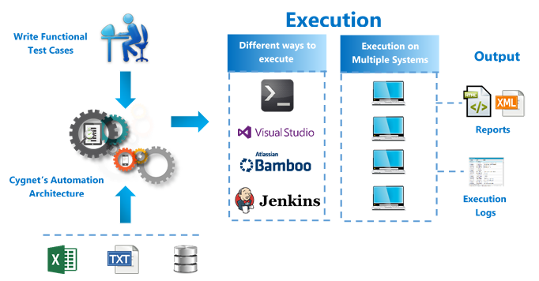
Automation Framework

Slide 25
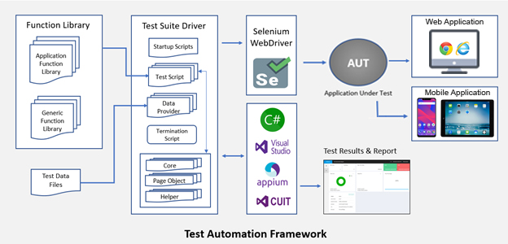
Automation Framework

Slide 26
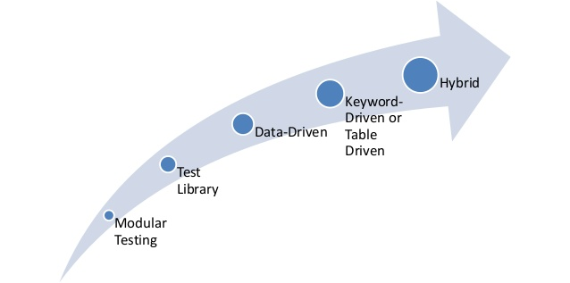
Automation Framework Evolution

Slide 27
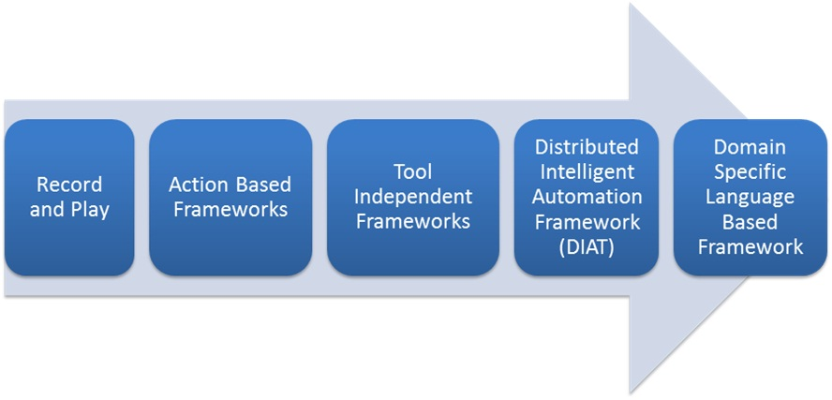
Automation Framework Evolution

Slide 28
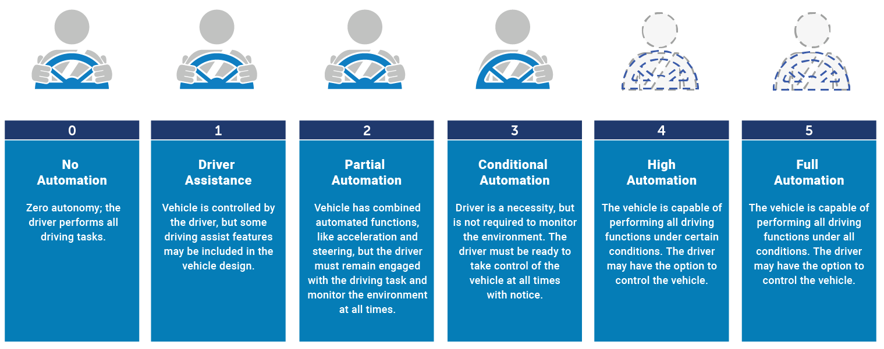
Automation Framework Evolution

Slide 29
Any Question?
End!

